Slide 1

RATING PREDICTION
Guided By:
Shubham Yadav
Presented By:
Gokula Krishnan R

Slide 2
INTRODUCTION
We have a client who has a website where people write different reviews for technical products. Now they are adding a new feature to their website i.e. The reviewer will have to add stars(rating) as well with the review.
The rating is out 5 stars and it only has 5 options available 1 star, 2 stars, 3 stars, 4 stars, 5 stars. Now they want to predict ratings for the reviews which were written in the past and they don’t have a rating.
Wehave to build an application which can predict the rating by seeing the review.

Slide 3
EXPERIMENTAL SET UP
Hardware requirements:-
1. Processor — core i5 and above
2. RAM — 8 GB or above
3. SSD— 250 GB or above
Software requirements:-
1. ANACONDA

Slide 4
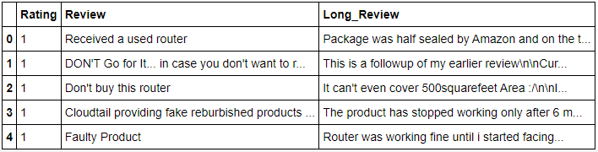
DATA PREPRATION
With the help of Pandas Library We will upload our data to Jupyter Notebook.
Once our data is uploaded with the help of predefined method (i.e. read_csv) we can read data for further processing.
We have two type of variables in the data:-
Dependent Variable
Independent Variable

Slide 5
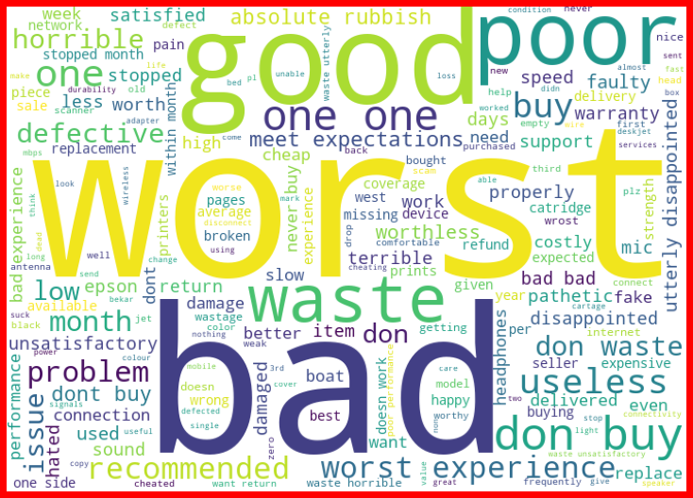
ONE STAR RATING

Slide 6
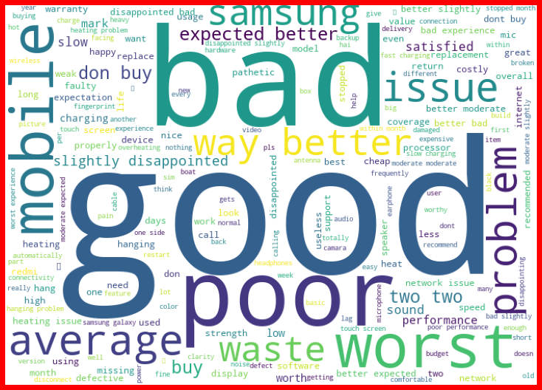
TWO STAR RATING

Slide 7
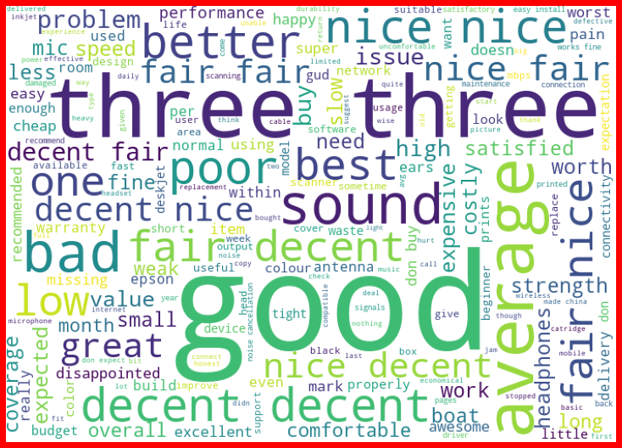
THREE STAR RATING

Slide 8

FOUR STAR RATING

Slide 9

FIVE STAR RATING

Slide 10
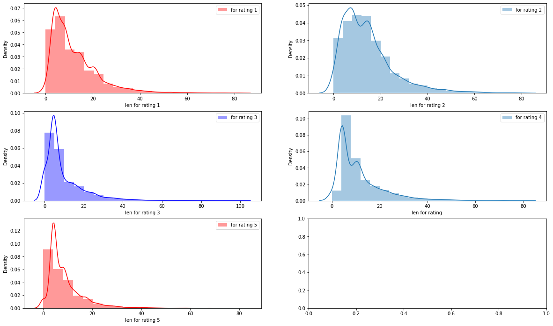

Slide 11
DATA PREPROCESSING
The Complete data is divided in the ration of 70:30 for train and test respectively.
There is no null value present in the dataset and almost all the columns type is objective so we don’t need to check for outliers.
Once our data is ready, we’ll do further processing.
I have not dropped any column since the model accuracy is good.

Slide 12

EVALUTION PROCESS
Evaluation Matrices:
Accuracy - it determines how often a model predicts default and non default correctly.
Precision-it calculates whenever our models predicts it is default how often it is correct.
Recall- Recall regulate the actual default that the model is actually predict.
Precision Recall Curve - PRC will display the tradeoff between Precision and Recall threshold.
Cross Validations:
K Fold cross validations , K = 5

Slide 13
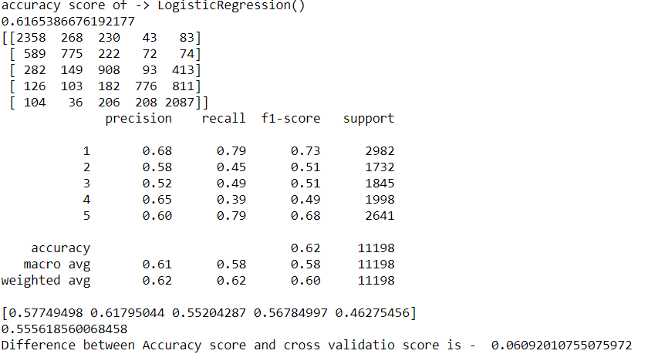
Logistic Regression

Slide 14
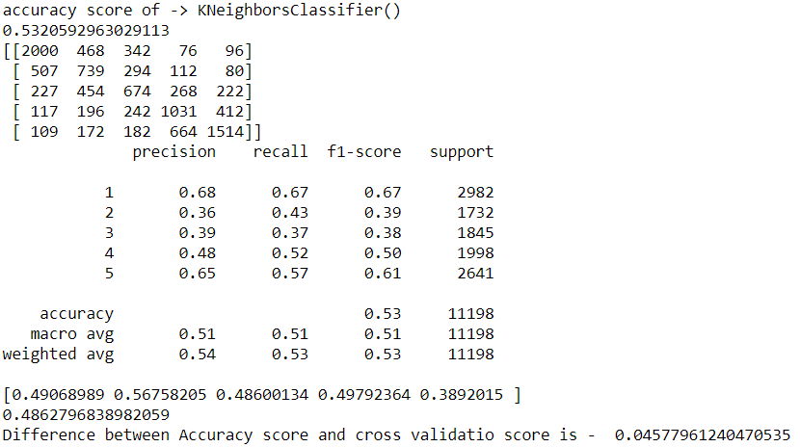
K-neighbors Classifier

Slide 15
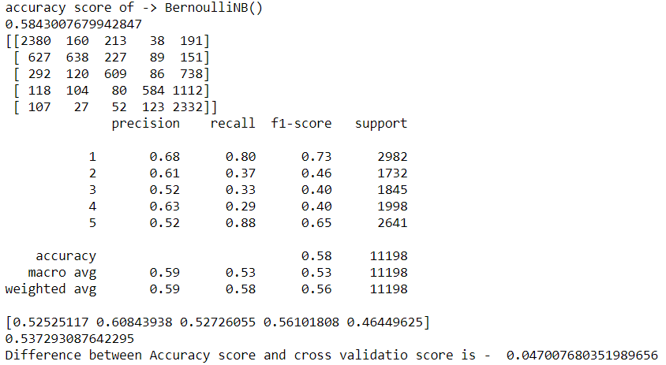
Bernoulli NB

Slide 16
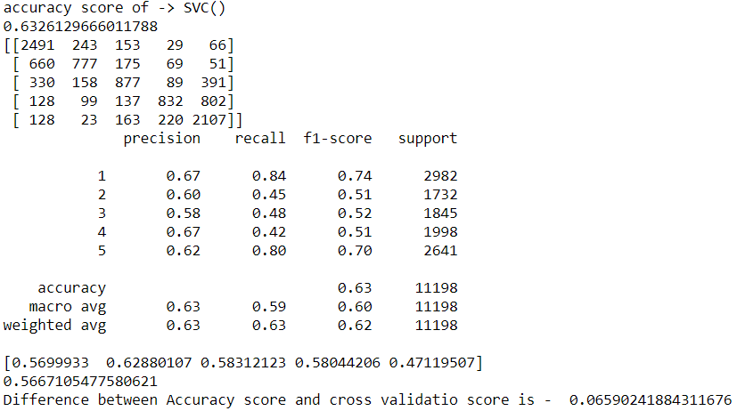
SVC

Slide 17
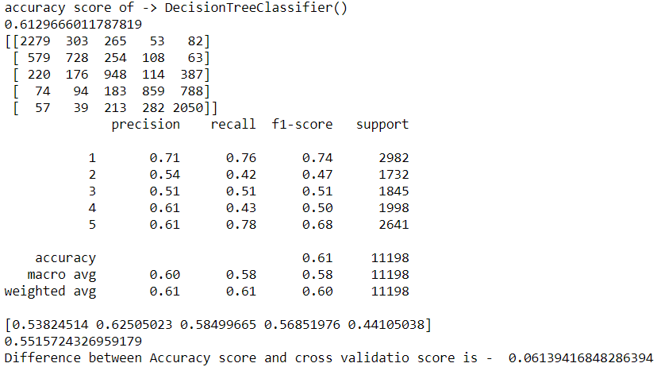
Decision Tree Classifier

Slide 18
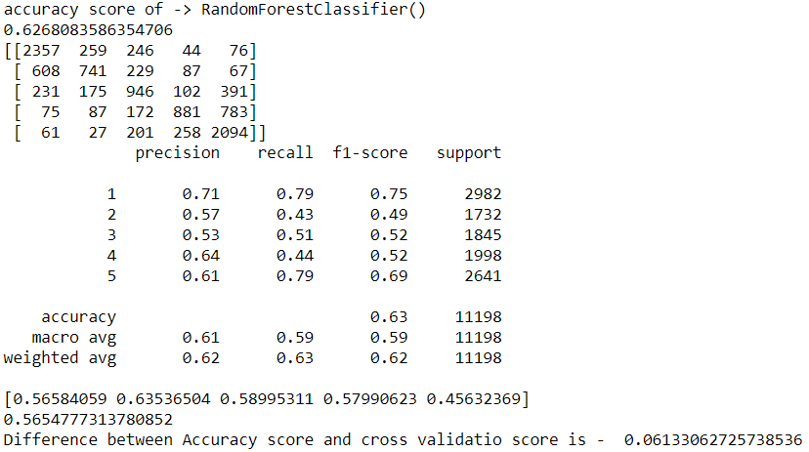
Random Forest Classifier

Slide 19
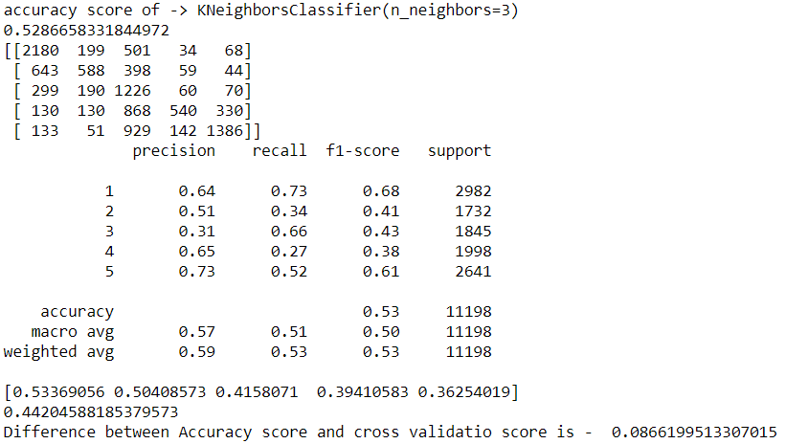
K neighbors Classifier (n_neighbors=3)

Slide 20
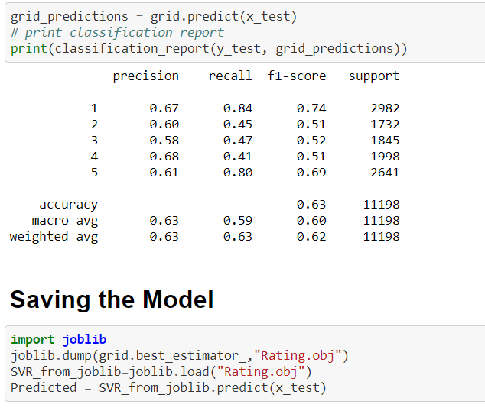
RESULT
From the details on the above solutions it is clearly understandable that we are getting best result with the help of SVC, so we save this model with the help of joblib Library.

Slide 21
CONCLUSION
As we know data is increasing in every second in our day today life. So more the data better the model.
If we make this dataset for sentiment analysis, we choose ratings 3 or more as our threshold for being helpful reviews or good or positive reviews and below 3 we choose reviews is not helpful or bad reviews or negative reviews.
For example: two people give their reviews on a product as ‘a nice product. But their ratings are ‘4’ and ‘5’ respectively. This is where the model fails to predict whether to choose rating ‘4’ or’5’.
Due to increase in data in our daily basics, this model can be used to predict ratings of reviews.
It might be a good tool for online shopping sites and manufacturer companies who may predict their customers ratings so that they can make their investment according to the demand of customers, which might help them to save time and earn more profits.

Slide 22
THANK YOU

